Slide 1

JOB-SYNC:
A comprehensive style guide

Slide 2
Table of Contents
Introductions...2
Logo and App Icon...5
Typography...6
Colors...7
Icons...8
Don'ts...10
Additional Information...11

Slide 3
Introduction
Job sync is an innovative platform designed to streamline job application process for applicants and it's able to enhance connections with hiring teams. It's a one way platform for job seekers and offering simple tools to simply searches, optimize resumes and provide personalized guides.
The platform focuses on providing seamless job search capabilities, personalized resume reviews, interview preparation and networking opportunities.
Any questions that need to be addressed can be directed to identity@JS.com.

Slide 4
Introduction Continued
Standard light mode and dark mode
We intend to implement the feature of having a complete light and dark mode respectively in our app.
Preparations
We will make sure our app is up to the complete standard before publishing the app, an app name and icon will be approved by JS and the backend team.

Slide 5




LOGO AND APP ICON
logo
As the main identifier for Job-Sync, this would be placed in the welcome page and this would be the only logo and app icon that should be used, so there should never be a problem with incorporating it in either a header or a footer.

Slide 6
Naming New App
App Icon
When naming a new app, please make sure that the following principles are applied.
The app Icon is the first impression and identity of the app and shall therefore represent the app's purpose. An app Icon is unique and exclusive for its app and shall not be used for other purposes or meanings. Hence, for each new app and icon created. Never use the JOBSYNC beta app icon.
Be in line with Job-Sync brand, express customer benefit, focus on the functionality of the app, be descriptive, follow industry practice., be consistent and most of all keep it short.

Slide 7
JobSync Typography Guide
The typography for JobSync, with its bold gradient background transitioning from blue (#0097B2) to green (#7ED957), reflects a sleek, modern, and professional aesthetic while ensuring readability. The recommended font family for headings is Bebas Neue or Montserrat, styled in extra bold or black for a futuristic feel, with main titles ranging from 44–52px and section headers between 30–38px. For contrast, the primary heading color should be deep navy (#003366) or white (#FFFFFF). Subheadings should use Raleway or Open Sans in semi-bold or bold, sized between 22–26px, and colored teal (#008080) or light green (#A4E57A) to maintain a tech-forward vibe. Body text, set in Roboto or Lato with regular or medium weight, should be sized 16–18px and use dark gray (#333333) or black (#000000) for clarity. Text should dynamically adjust to maintain legibility on both dark and light sections of the gradient background. Callouts and highlights can use Poppins or Nunito in bold or italic, matching body text size but using electric blue (#0073E6) or vibrant green (#4CAF50) for accent colors. For quotes and testimonials, Merriweather or Georgia in italic should be used, sized 16–18px, with soft cyan (#A7E0E8) or off-white (#F5F5F5) colors for a subtle, distinguished look. Button text should be Montserrat or Bebas Neue, styled in bold, all caps, sized 16–18px, with white (#FFFFFF) text on a deep blue (#005A9E) or neon green (#00CC66) background to create a clear call to action. The typography guidelines emphasize ample spacing, clear alignment—left for text-heavy sections and center for headers or call-to-action elements—and a seamless integration with the bold, structured look of the JobSync logo. By combining high-contrast fonts, dynamic styling, and a cohesive layout, JobSync creates a modern, tech-forward aesthetic tailored to its audience.

Slide 8
Colors
These colors together create a vibrant, professional, and approachable feel for JobSync, helping it establish a strong brand identity that resonates with users looking for a reliable, forward-thinking job-search platform.

Slide 9
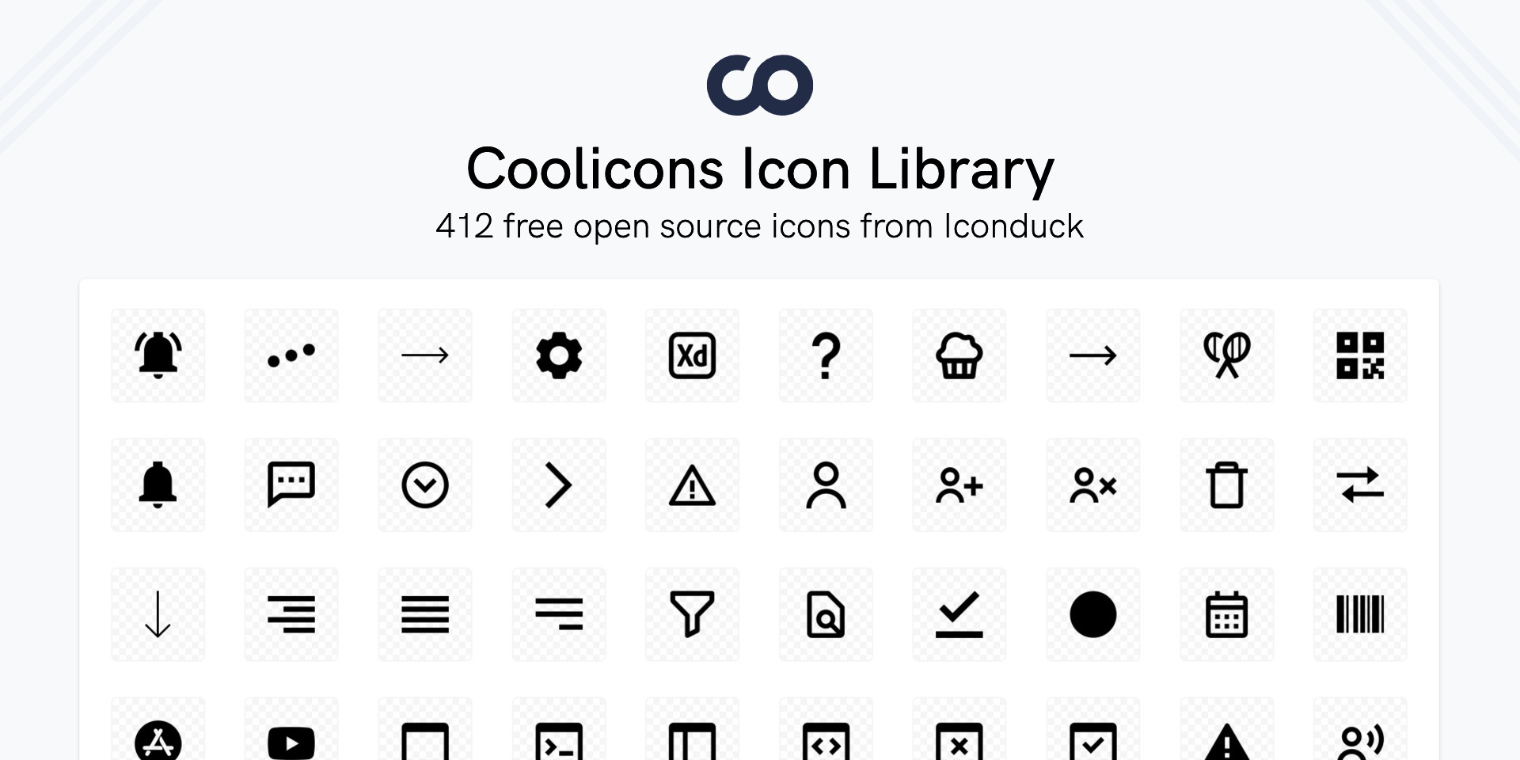
ICONS
The icons should be used from the coolicons library on Figma and the star ratings library in Figma. Any other miscellaneous icons will be located on the JOB-SYNC Primary website under development reference

Slide 10
DON'TS
DON'T USE UNAPPROVED COLORS.
Don't reproduce any part of the of the JOB-Sync logo in any other color than it's original.

Slide 11
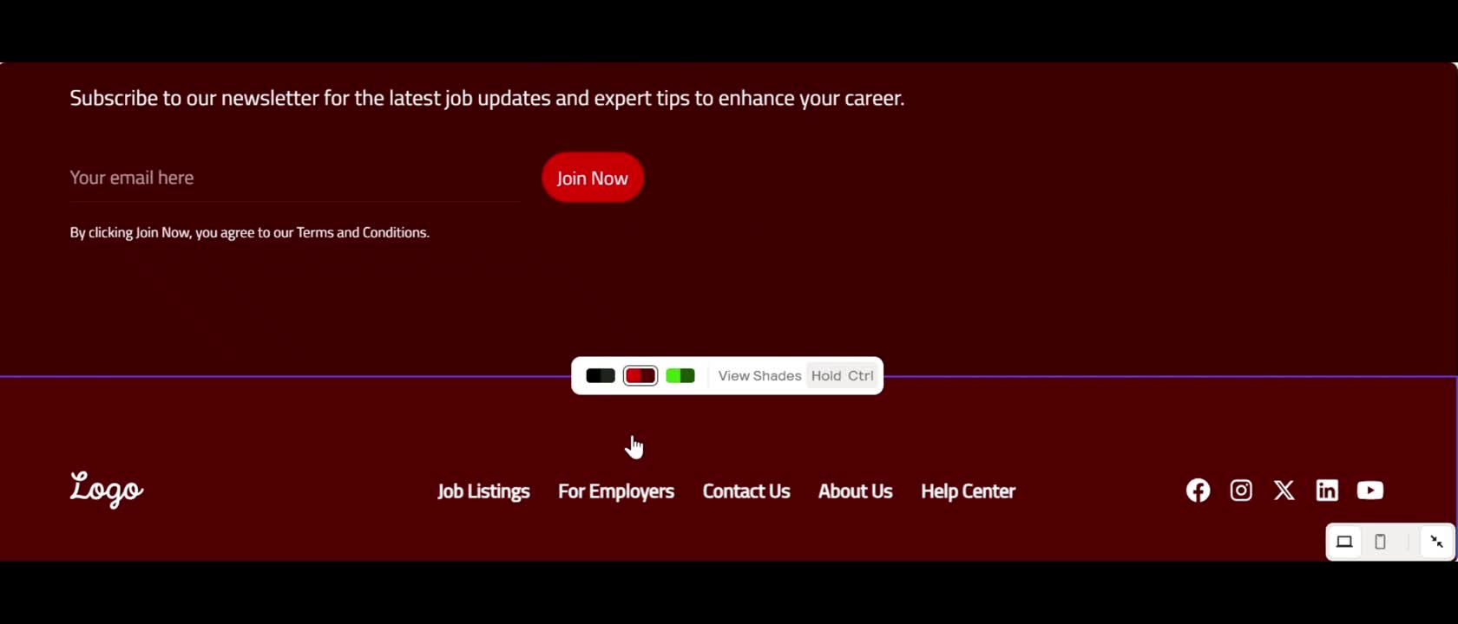
DON'T USE UNAPPROVED COLORS.
Don't reproduce any part of the of the JOB-Sync logo in any other color than it's original.

Slide 12
Additional Information
If you have any questions, comments, concerns or complaints regarding stylistic details, please contact us at:
support@jobsync.com
Or
Marcus3.jones@famu.edu

